Slide 1
Text Summarization
Kiel Rotz
Springboard Data Science Capstone
December 2021

Slide 2
What is text summarization?
Text summarization is the method of extracting summaries from original text without losing any vital information
It is typically grouped into two categories of methods: Extractive & Abstractive
Extractive summarization seeks to identify the most significant sentences of the text and use them to create a summary.
Thus, the summary contains the exact sentences from the original text.
Abstractive summarization seeks to identify the important sections and interpret the context in order to generate sentences for the summary.

Slide 3
What is it used for? OR other noteworthy questions to explore

Slide 4
Our Goals
To explore the current state of text summarization and compare different models and different approaches.
To give a guided walkthrough of building a text summarization model for both an extractive and abstractive approach, and to compare various pre-build and pre-trained models.
To give a brief introduction in how to compare text summarization models.

Slide 5
The Data from Kaggle website
Original data features
Pre-processed data features
wiki_movie_plots_deduped.csv
Release Year, Title, Origin/Ethnicity, Director, Cast, Genre, Wiki Page, Plot
movies_metadata.csv
adult, belongs_to_collection, budget, genres, homepage, id, imdb_id, original_language, original_title, overview, popularity, poster_path, production_companies, release_date, revenue, runtime, spoken_languages, status, tagline, title, video, vote_average, vote_count
df_final.csv
Release Year
Title
Plot
Overview
cleaned_plot
cleaned_overview

Slide 6
Data preprocessing
Loaded and merged the two csv files
Dropped all unnecessary columns
Created the cleaned_overview and cleaned_plot columns by:
Convert everything to lowercase
Remove HTML tags
Contraction mapping (Don’t → do not)
Remove possessives (-’s)
Remove text inside parenthesis
Eliminate punctuations and special characters
Remove stopwords
Why is it necessary to preprocess in NLP?
Machine learning algorithms perform better if the text is given in a more digestible form.

Slide 7
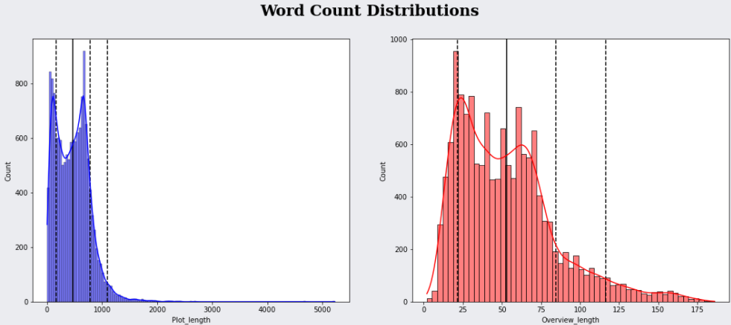
Data Exploration and trimming
Plots greater than 600 words and overviews greater than 125 words were cut.
The extreme outliers would have been cut anyway to help the models learn better, but most importantly we needed to trim to ease the computational burden on the computer.

Slide 8
Problems
CUDA

Slide 9
Evaluation Metrics

Slide 10
Extractive Models

Slide 11
Spacy

Slide 12
LSA

Slide 13
Luhn

Slide 14
Abstractive Models

Slide 15
Encoder-Decoder Seq2Seq RNN walkthrough

Slide 16
T5

Slide 17
BART

Slide 18
Results

Slide 19
Summary

